Slide 1
First- and Last-Touch Attribution with CoolTShirts.com
Learn SQL From Scratch
Eric Lord
August 6, 2018

Slide 2
Table of Contents
1. Get familiar with CoolTShirts.com
How many campaigns and sources does CoolTShirts use and how are they related?
What pages are on their website?
2. What is the user journey?
How many first touches is each campaign responsible for?
How many last touches is each campaign responsible for?
How many visitors make a purchase?
How many last touches on the purchase page is each campaign responsible for?
What is the typical user journey?
3. Optimize the campaign budget
CoolTShirts can re-invest in 5 campaigns. Which should they pick and why?
Appendix
What SQL queries were used to gather this information?

Slide 3
Get familiar with cooltshirts.com
Part i

Slide 4
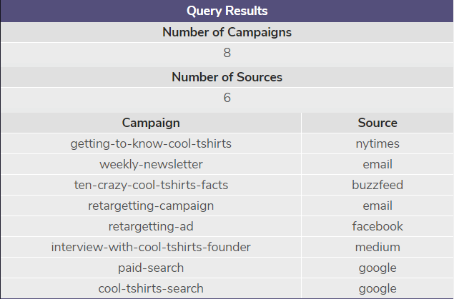
How many campaigns and sources does CoolTShirts use and how are they related?
CoolTShirts is currently running 8 campaigns across 6 digital media.
Specifically, they are running:
Two search campaigns on Google,
Paid content campaigns on Medium, Buzzfeed, and the NY Times website,
A weekly content newsletter via e-mail,
Retargeting ads on Facebook and e-mail
Note that here a ‘campaign’ represents a marketing initiative and a ‘source’ is the medium on which it is running.

Slide 5

What pages are on their website?
There are four pages on the CoolTShirts.com website:
The initial landing page,
A shopping cart page, which displays the items the user has added to their cart,
A checkout page, where the user enters payment information and confirms the purchase,
A purchase confirmation page
Together, these make up a standard e-commerce purchase funnel.

Slide 6
2. What is the user journey?
Part II

Slide 7
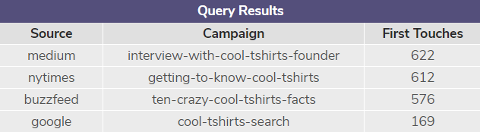
How many first touches is each campaign responsible for?
There are four campaigns generating new first-touch traffic for CoolTShirts.com:
The Medium interview generated 622,
The NYTimes article generated 612,
The Buzzfeed article generated 576,
The Cool T-Shirts Google paid search generated 169
Note that it makes sense that the retargeting campaigns are not generating first touches; by definition, they only target past visitors!

Slide 8
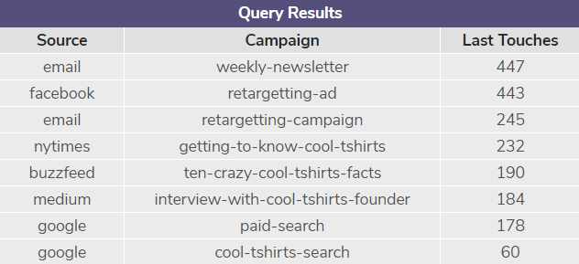
How many last touches is each campaign responsible for?
All eight campaigns are generating last touches!
The e-mail newsletter campaign is generating the most last touches, with 447.
The retargeting campaigns in general are performing very well, with each near the top of the list.
Overall, the Google paid search campaign is underperforming, with 0 first touch and only 178 last touch attributions.
While this data is interesting, it doesn’t account for whether users purchased anything or not. Users who fell out of the funnel are counted here as well.

Slide 9

How many users made a purchase?
In total, 361 users made a purchase.
Note that in the last exercise, our total last touches added up to 1,979.
This is because the previous exercise tracked the last touchpoint of all users who visited the website, whether they made a purchase or not.

Slide 10
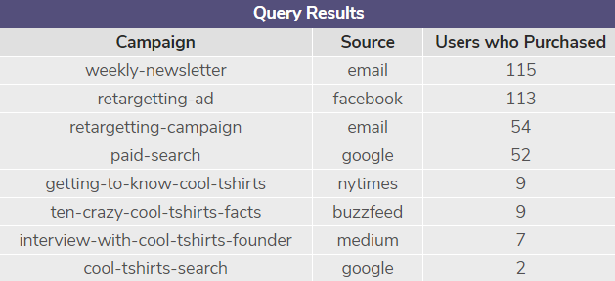
How many last touches on the purchase page is each campaign responsible for?
Each of CoolTShirts’ eight campaigns are generating purchase conversions.
The weekly newsletter e-mail campaign generated the highest raw number of conversions, at 115.
Again, the e-mail and Facebook retargeting campaigns are generating the highest number of conversions via last-touch attribution.

Slide 11
What is the typical user journey?
Initial Engagement
Reengagement
Purchase
Over 90% of users first come to the site via paid content campaigns, such as the Medium interview or the NYTimes story.
Most users do not make a purchase on their first visit to the website, requiring additional engagement via retargeting to finally convert.
After multiple touches, users finally convert to a purchase. In 78.1% of cases, users who purchase have a retargeting or e-mail subscription as their last attributed touch.

Slide 12
Optimize the campaign budget
Part III

Slide 13
CoolTShirts can re-invest in 5 campaigns. Which should they pick and why?
Campaign | Source | First Touches | % First Touches | Purchases | % Purchases
Getting to Know | NY Times | 612 | 30.9% | 9 | 2.5%
Crazy Cool Facts | Buzzfeed | 576 | 29.1% | 9 | 2.5%
Interview | Medium | 622 | 31.4% | 7 | 1.9%
Paid Search | Google |  |  | 52 | 14.4%
Cool T-Shirts Search | Google | 169 | 8.5% | 2 | 0.6%
Weekly Newsletter | E-Mail |  |  | 115 | 31.9%
Retargeting | E-Mail |  |  | 54 | 15.0%
Retargeting | Facebook |  |  | 113 | 31.3%

Slide 14
CoolTShirts can re-invest in 5 campaigns. Which should they pick and why?
Understanding that both initial first-touch engagement and final retargeting to conversion are important in CoolTShirts’ typical user journey, we should aim to keep some activity at both ends of the funnel.
The three most effective top-funnel campaigns are the NY Times article, the Medium interview, and the Buzzfeed list.
The two most effective bottom-funnel campaigns are the E-Mail newsletter and the Facebook retargeting.
Based on the available information, these are the campaigns that should be kept.
Naturally, the cost and ROI of each campaign are also critical in determining their overall effectiveness. Since that information is not given, I’ve focused on raw overall traffic and purchase conversions as my key performance indicator.

Slide 15
SQL Queries
Appendix

Slide 16
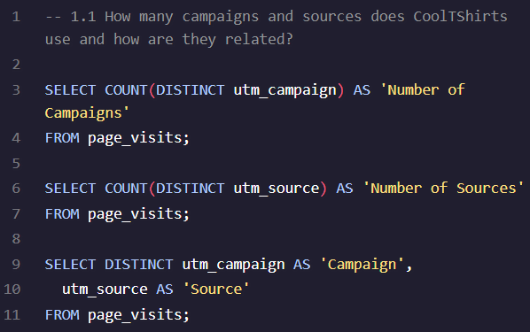
What queries were used for Question 1.1?
This code creates three separate tables.
First, we count distinct campaigns and sources.
Then, we SELECT DISTINCT both to generate the full list and see how they relate to each other.

Slide 17
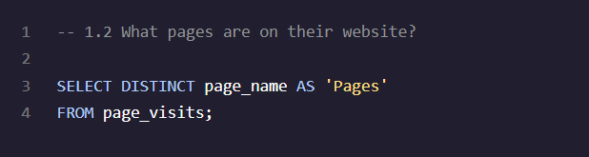
What queries were used for Question 1.2?
SELECT DISTINCT used to generate a list of pages.
‘Pages’ alias used for readability.

Slide 18
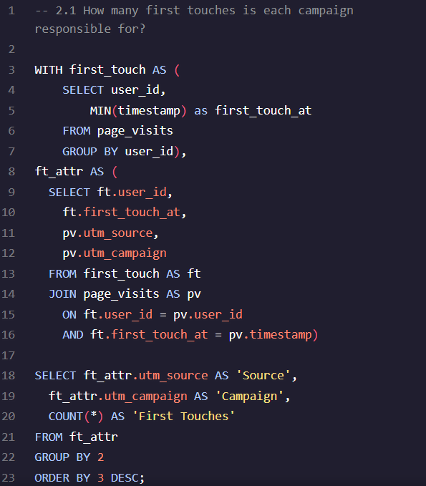
What queries were used for Question 2.1?
Two temporary tables (first_touch, ft_attr) created to organize data for the final query.
‘ft’ and ‘pv’ aliases used to save space and improve readability.
Column aliases used to improve output readability.

Slide 19
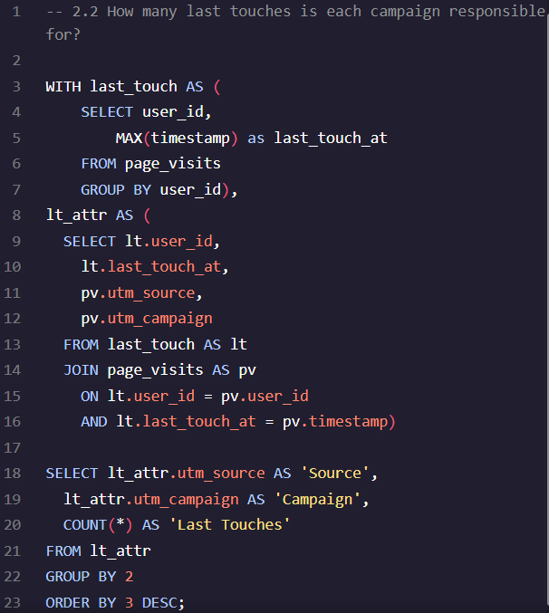
What queries were used for Question 2.2?
This code is very similar to Question 2.1, with references to first touches replaced with last touches.

Slide 20
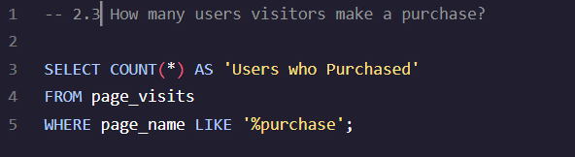
What queries were used for Question 2.3?
Simple count of rows with ‘purchase’ in the page name string.
The % variable string character was used to ensure that all purchase events were captured.

Slide 21
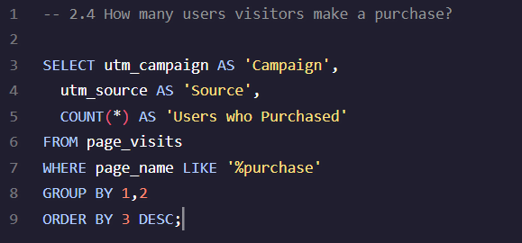
What queries were used in Question 2.4?
While the exercise recommends modifying the last touch query to filter out only purchases that are the last touch; however, since by definition a purchase will always be the last touch in the funnel it seemed easier and more elegant to pull the rows directly from page_visits rather than construct a redundant temporary table.

